Slide 1
Facebook Network Graph Analysis
Algorithm Project
Date: 25/5/2023

Slide 2
Meet our Team
Mohamed Elshaarawy -120200168
Ashrakat Saeed -120200091
Abdelrahman Said -120200075
Mariam Ahmed Sheta- 120200183
Asem Mohamed -120200089

Slide 3
Table of contents
01
02
03
Project Overview
Data Scraping
Graph Analysis
04
05
06
Results
Conclusions
Future Work

Slide 4
Project Overview
Our project focused on conducting network graph analysis using data collected from four Facebook groups.
The data was scraped from these groups to create a visual representation of the network graph, which was then analyzed using graph tools.
Various algorithm techniques were applied to the graph to extract important insights and explanations.
Each algorithm provided valuable results that shed light on different aspects of the graph and its underlying structure.
Understanding how these algorithms work and their application to our graph was crucial in obtaining relevant and relatable results.
The results obtained from the analysis have implications and benefits across multiple domains, particularly in the field of social sciences.

Slide 5
Data Scraping
The dataset consists of usernames for 4 Egyptian public groups on Facebook. Each member in each group is considered a node, and the edges between them indicate that they are in the same group
Approximately 140,000 members were scraped from these groups, and a random sample of 20,000 members was chosen for analysis.
An edge list was created to represent the relationships between the selected members, considering members in the same group as connected.
A scraping technique was used to extract information about the number of friends each member had, but due to privacy settings, only 10,000 accounts allowed access to their friend lists.
A maximum limit of 100 friends was set for scraping from each account to manage the dataset.

Slide 6
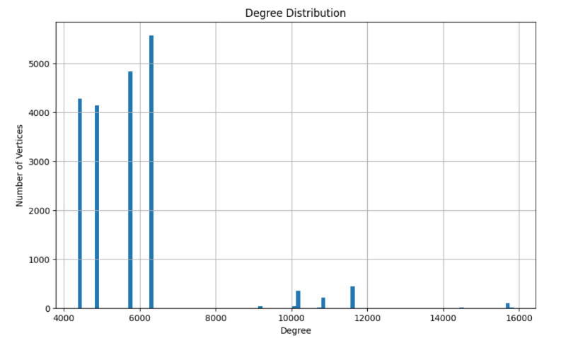
Graph Analysis
The distribution of node degrees in the network is examined to understand the connectivity patterns and identify highly connected nodes
Time complexity of used algorithm is O(N).
Degree Distribution Analysis
Result
It can be deduced that a subset of ap- proximately 500 vertices demonstrates a substantial degree of connectivity, as evidenced by their involvement in approximately 12000 edges.
This implies a significant level of interconnectivity and information flow.

Slide 7
Graph Analysis
The examination of shortest paths between nodes in the network is carried out to investigate the accessibility and connectivity among members.
The Algorithm Used is Dijkstra's algorithm and the time complexity is O(N^2).
Path Analysis
Result
Graph diameter equals 2, signifies that the maximum shortest path length between any two vertices in the graph is 2.
This implies a high level of connectivity and accessibility within the graph, indicating efficient communication and information transfer between vertices.

Slide 8
Graph Analysis
Three types of centrality are employed including degree centrality (O(N)), betweenness centrality, and closeness centrality (O(V * (V + E)) to to identify the most influential nodes within the network.
Centrality Analysis
Result
The largest Degree Centrality value of 15868 indicates that there is a node in the graph with the highest number of connections to other nodes.
The largest Betweenness value of 1853798 indicates that there is a node in the graph that plays a critical role in connecting different parts of the network.
The largest Closeness value of 0.828802 indicates that there is a node in the graph that is relatively closer to all other nodes.

Slide 9
Graph Analysis
In this analysis, distinct subgroups or communities within the network are identified by examining the connected components.
The algorithm used is based on a depth-first search (DFS) traversal. The time complexity is O(N + E)
Connected Components Analysis
Result:
Number of Connected Components: 1
Connected Component 1: Size = 20000 Nodes
The result of having only one connected component with a size of 20000 implies that all vertices in the graph are interconnected and form a single cohesive unit. This implies high level of connectivity and coherence within the network allowing for efficient communication.

Slide 10
Graph Analysis
In the clustering coefficient analysis, the extent to which nodes in the network cluster together is assessed.
To perform the clustering coefficient analysis, the local clustering function is utilized using algorithm with time complexity O(N + E).
Clustering Coefficients
Result
This graph indicates that the clustering coefficients is 0.9718.
This result indicates a high level of clustering or connectivity.
within the graph.
Triangles: 115278616
Average number of triangles: 5763.930

Slide 11
Graph Analysis
The time complexity of the transitivity algorithm is dependent on the size of the network. In our case, the time complexity is approximately $O(n^3).
It is important to note that graph-tool may employ optimizations or techniques to improve the efficiency of the algorithm
Transitivity
Result
Transitivity of the graph: (0.895609646462258, 0.0027147177162341303)
The first value, 0.895609646462258, represents the transitivity coefficient implies A higher transitivity coefficient indicates a greater tendency for nodes to form clusters.
The second value, 0.0027147177162341303, is the p-value associated with the transitivity coefficient.

Slide 12
Graph Analysis
The level of interconnectness within the network is quantified by calculating the density and the time complexity of this algorithm is O(N + E).
Density Analysis
Result
Graph Density: 0.2882109505475274
Given the no. of vertices (20000) and the no. of edges, the relatively high graph.
Density suggests that the vertices in the graph are well-connected, indicating a relatively dense network of relations or interactions between the entities represented by the vertices.

Slide 13
Graph Analysis
This analysis Is performed using the Louvain algorithm and its time complexity is approximately O(n log n)
Community Discovery
Result
4 Different communities
• Graph is Undirected
• Graph is connected.
• Network is not homogenous.

Slide 14
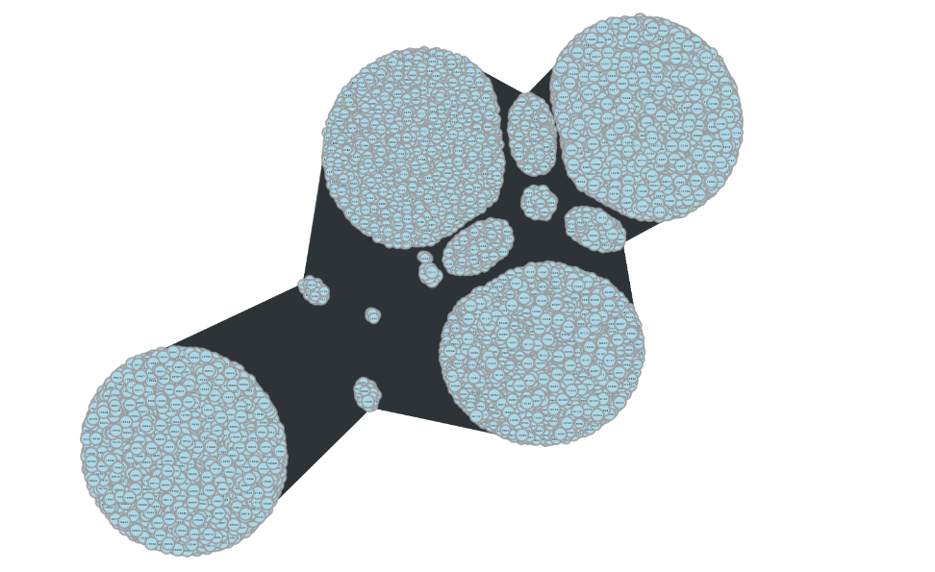
Network Visualization

Slide 15
Conclusions
10,000 users from a total of 140,000 users(7%), their accounts are public. and
we reached their friends. In social sciences these data and graphs
could be used for demographic studies and behavior studies
for these people a social behavior.
From our study , we concluded that there’s no one member existed in all four groups.
About 0.5 % of the members are existed in at least two groups.

Slide 16
Future Work
In our future work, we aim to Scrape additional user data for a deeper understanding of individual profiles and behaviors and to use it to deploy machine learning models like:
Implementing a machine learning model to predict whether an unseen member belongs to which communities in our groups utilizing their profile information (Age, University, Residence, work…etc).

Slide 17
Thanks!
Do you have any questions?
Please keep this slide for attribution

